Slide 1
Kali Linux Forensics: Binwalk
By Jack Hill, Andrew Proctor, and Cole Houston

Slide 2

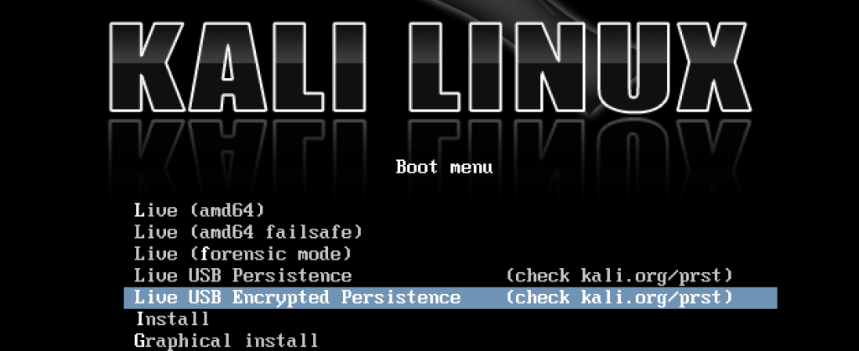
Intro to Kali Linux
Debian-derived Linux distribution
Digital forensic and penetration testing focused
Over 200 built in tools - https://tools.kali.org/tools-listing
Capability to run live off of a USB

Slide 3
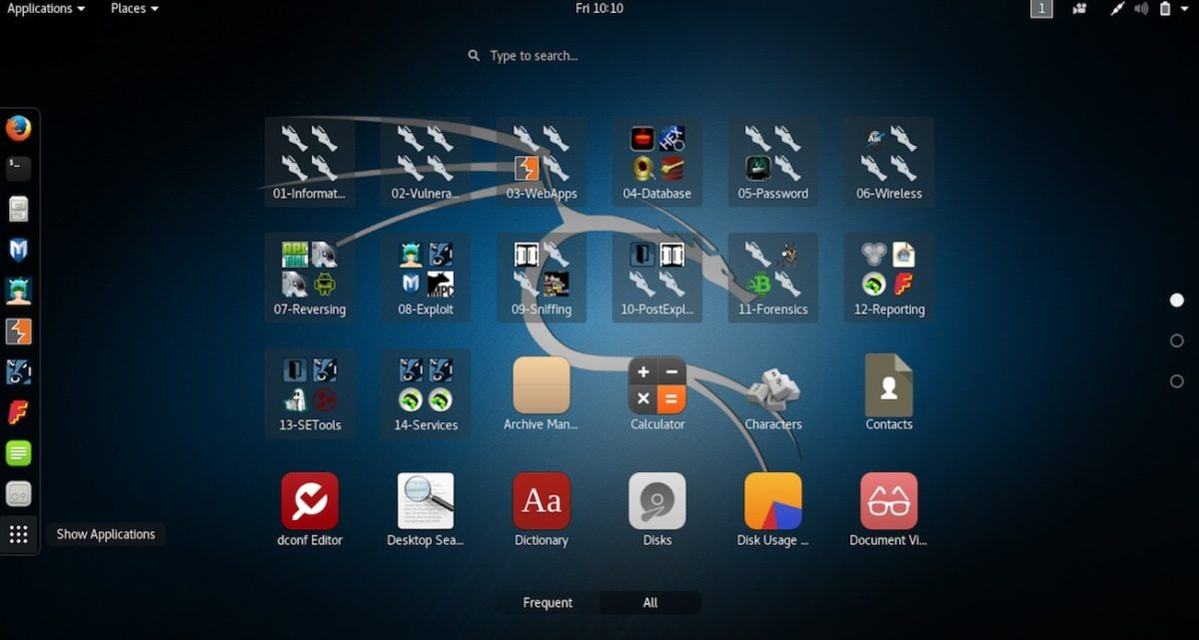
Tool Topics
Over 200 tools covering topics such as:
Information Gathering
Vulnerability Analysis
Wireless Attacks
Web Applications
Exploitation Tools
Stress Testing
Forensic Tools
Sniffing & Spoofing
Password Attacks
Maintaining Access
Reverse Engineering
Reporting Tools

Slide 4
Intro to Binwalk
Command line tool
Can extract hidden files
Look for opcodes
Entropy analysis
Binary diffing

Slide 5
Binwalk -W
“Perform a hexdump / diff of a file or files”
Binwalk -W [file1] [file2] [file3] ...

Slide 6
Binwalk -D
“Extract <type> signatures, give the files an extension of <ext>, and execute <cmd>”
Binwalk [-y <type>] -D <type>:<ext> [file1]

Slide 7
Binwalk -Y
“Identify the CPU architecture of a file using the capstone disassembler”
Binwalk -Y [--verbose] [file1] | head -n 25

Slide 8
Questions?

Slide 9


Team Slide
Cole Houston
Jack Hill
Andrew Proctor
Cybersecurity Major
Member of CDC
Cybersecurity / Computer Science Double Major
Member of CDC
Cybersecurity Major
Member of CDC

